Slide 1
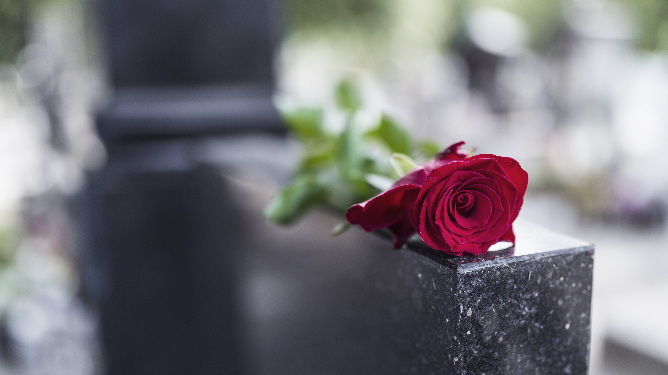

Yvonne Quiachon Cleveland, Ohio BS: Cleveland State University, OH, U.S.A. (Biomedical technology) September 11, 2021
Analysis on Traditional and Non-Traditional Burial in U.K. from 2016-2021
Data Science Capstone Project, May 5th 2021 Cohort

Slide 2
Slideshow Timeline
Introduction
Exploratory Data Analysis
Tableau – Mapping, Bar chart, Treemap
Data Acquisition and Cleaning
Modeling
Feature Engineering
Answering Our Questions
Assumptions and Limitations

Slide 3
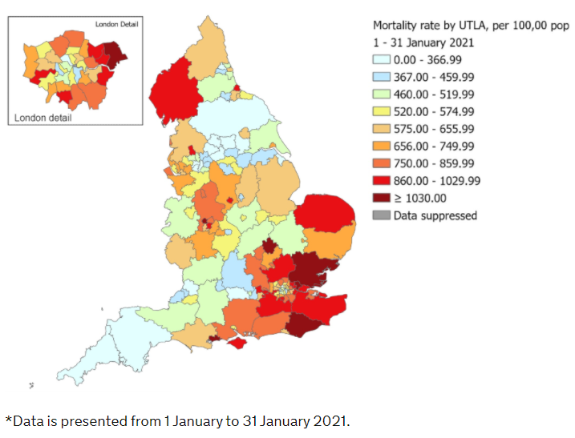
Introduction
Context
219 million Covid-19 cases and ≈ 4.55 million deaths globally.
6.86 million cases and 133,178 covid-related deaths in U.K.
Is there a growing demand for non-traditional burial in the U.K.?
What would burial rates look like if Covid-19 did not happen?
Burials as well as cemetery upkeep costly, both fiscally and environmentally.
Funeral costs:
Southwest England: £4,500
London: £6,000
Environmental costs:
Cremation uses ≈ 400 kg of CO2 (eq. to 500 mi. car trip!)
Cremation releases toxic gases
Burial materials not reusable and slow decomposition rates
Quarter of England’s cemeteries expected to be full by 2023.

Slide 4
Data Acquisition and Cleaning
Public Health Funeral Records (West Yorkshire, UK)
Cremations in the British Islands
Sources:
Office for National Statistics
Calderdale Metropolitan Borough Council
Wikipedia
Google maps
BBC News
Data.gov.uk
Individual borough’s websites (for burial fees)
Cemetery websites
Secondary data collection for burial data (burial sites, no. graves/bodies per site, coordinates, burial fees)

Slide 5
Exploratory Data Analysis

Slide 6
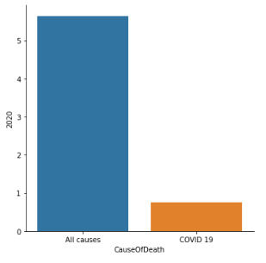
Number of deaths from districts of England
2020: Cause of death recorded as either from Covid-19 or other causes
419,309 records
BBC News: In 2020, 5.3 million recorded cases of Covid-19 in U.K., with total of 128,642 deaths.
Source: Office for National Statistics

Slide 7
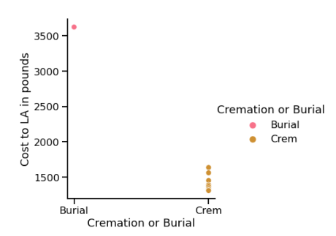
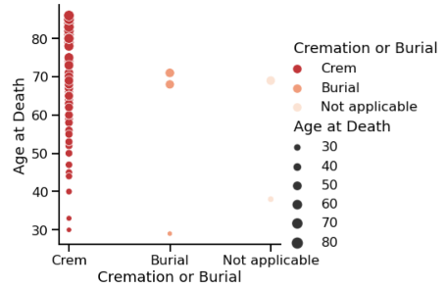
Cremation vs. Burial
Source: Calderdale Metropolitan Borough Council
Entries: 78
Entries: 78
Burials: >£350
Cremations: =>£1700
Cremation more popular
Majority of age of death =>50 y.o.

Slide 8
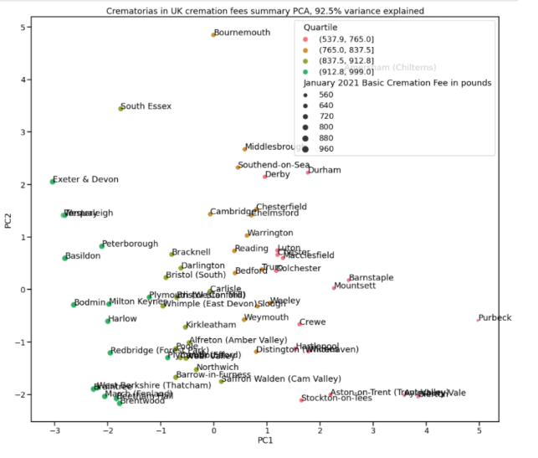
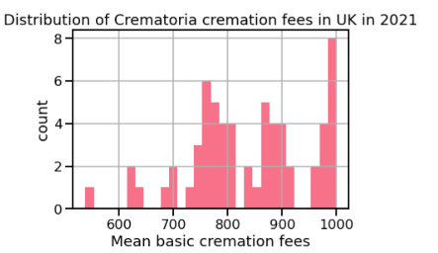
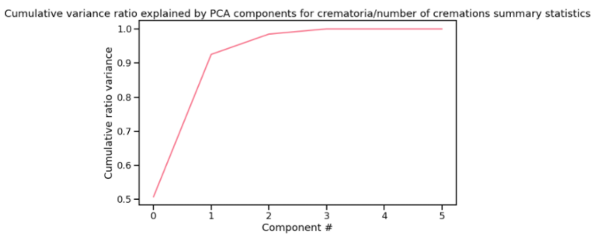
Crematoriums
Source: Calderdale Metropolitan Borough Council
62 Records
Most cremation fees are >£750
Clustered based on color; majority of green points are closer to London whereas majority pink points are farther away from London or located in rural parts near London.
PC1 explains almost 95% variance, PC2 explains almost 100% total variance

Slide 9
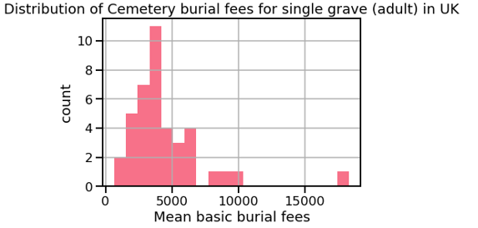
Burial data
Secondary data collection:
Wikipedia, Google maps, BBC News, data.gov.uk, borough council’s websites, UK cemetery websites.
Data from 2016-2021.
Cemetery website examples:
https://www.royalgreenwich.gov.uk/info/200144/deaths/1644/grave_burial_and_memorial_costs
https://beta.lambeth.gov.uk/bereavement-services/our-cemeteries-and-crematoria/bereavement-services-fees-charges
https://www.rbkc.gov.uk/births-deaths-marriages-and-citizenship/deaths/cemetery-services
https://www.southwark.gov.uk/assets/attach/4824/southwark-council-cemetery-fees-18-19.pdf
https://iccslondon.co.uk/app/uploads/2020/04/ICCS-Fees-2020.pdf
https://iccslondon.co.uk/app/uploads/2021/03/ICCS-Fees-and-Charges-2021-2022.pdf
Single, adult grave average cost: <£5,000 (~£2,000 to £4,000)
40 Records

Slide 10
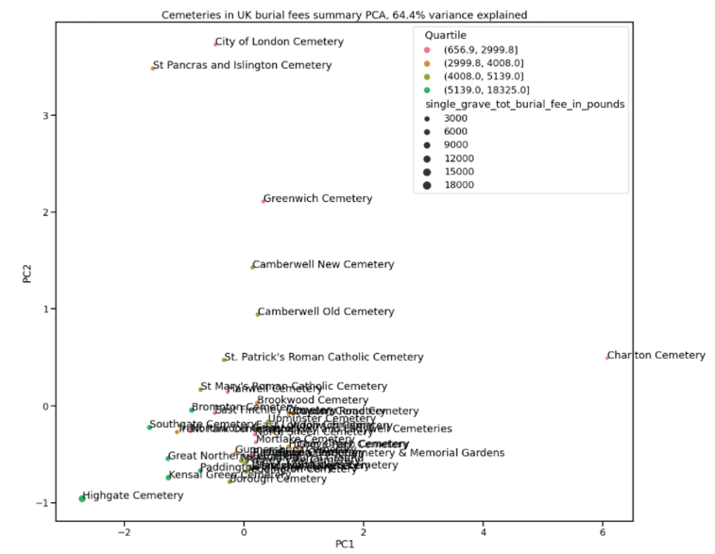
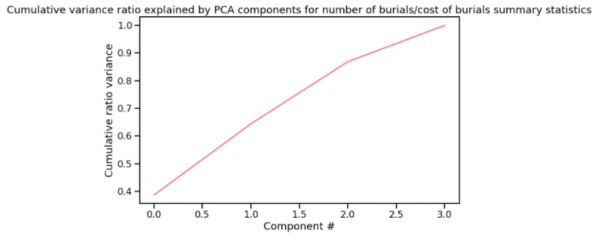
Principal Component Analysis for Burial Data
PC1 explains only 65% variance, PC2 explains 90% variance, PC3 100% variance.
Possible error: Wrong coordinates for Charlton Cemetery
Four outliers.
Highgate Cemetery in the left-most side (negative) and Charlton Cemetery on the right-most side (positive).

Slide 11
Tableau – Mapping, Bar chart, Treemap

Slide 12
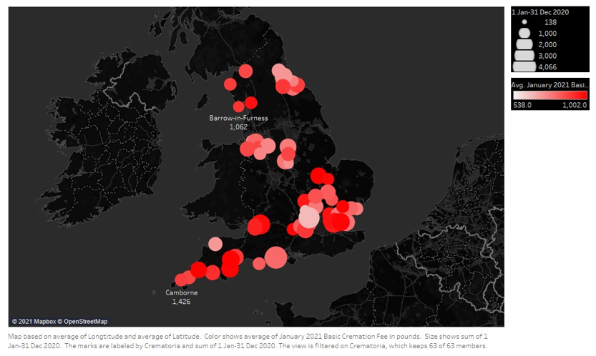
Map - Crematoriums
Mountsett
Durham
Peterborough
Westerleigh
Aylesbury Vale
Braintree
Exeter & Devon
Basildon
Barnstaple
Amersham (Chilterns)
Torquay

Slide 13
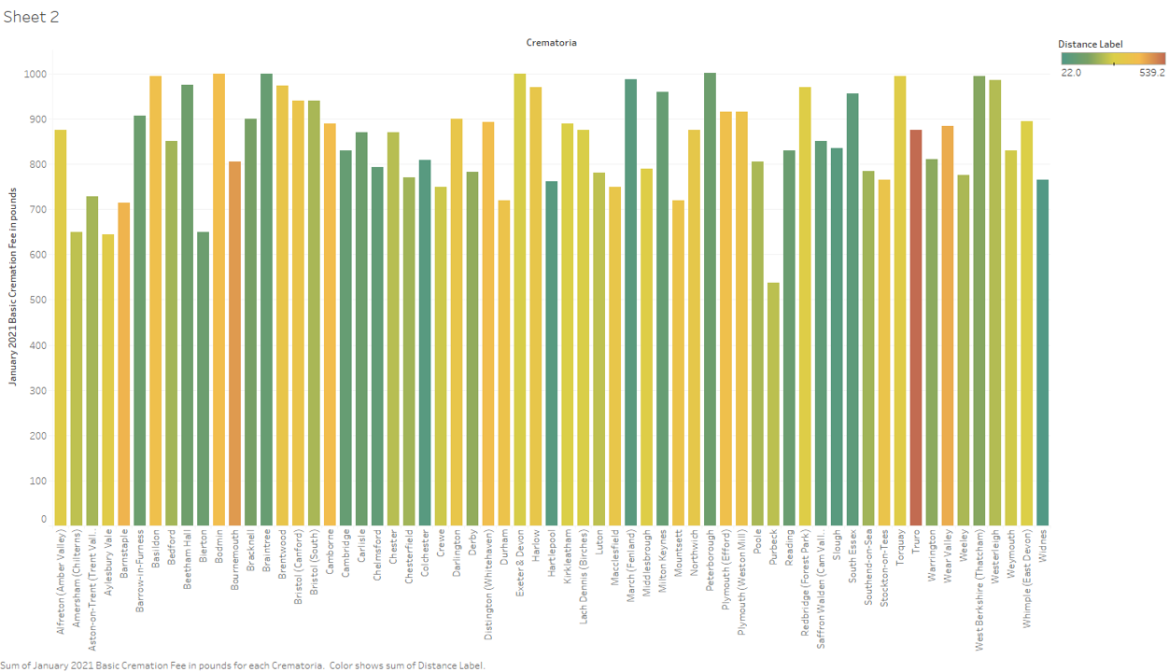


Slide 14
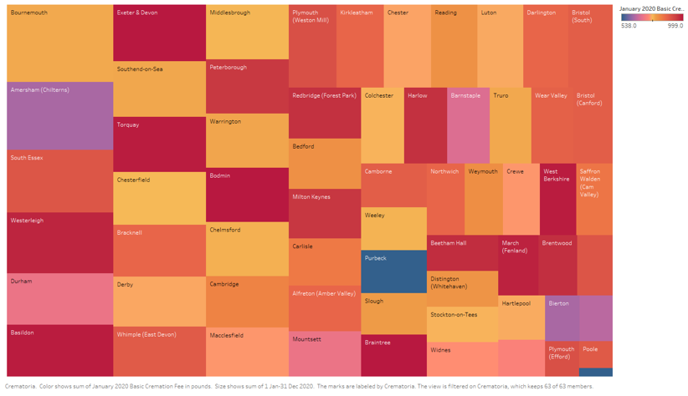

Slide 15
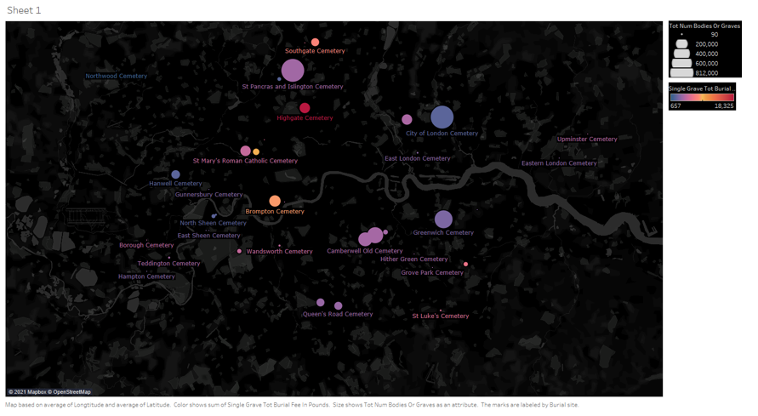
Map - Burials

Slide 16
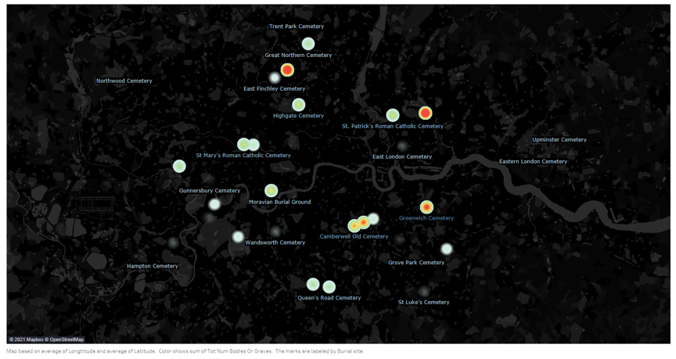
MaP – Burials (density)

Slide 17
Feature Engineering

Slide 18

One-Hot Encoding
Cremation vs. burial, crematorium, and burial datasets
Random Forest Regression
Linear Regression
Standard Scaler
Feature Scaling Techniques

Slide 19
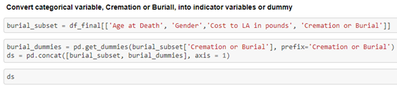
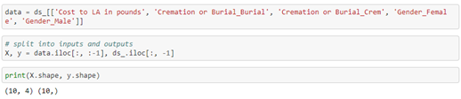
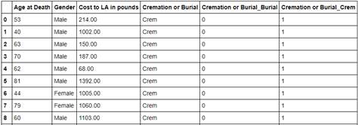
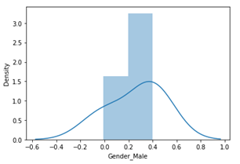
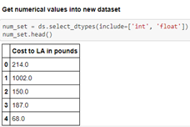
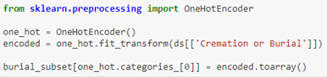
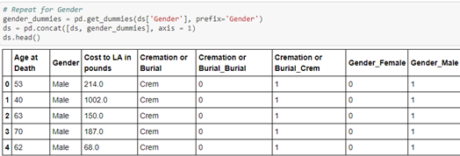
Cremation vs. Burial – Random Forest Regression

Slide 20
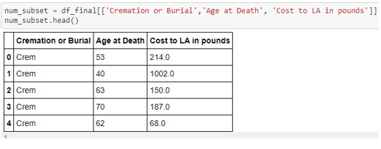
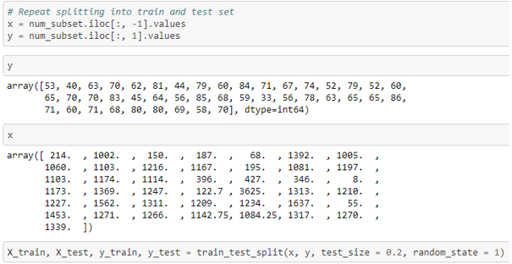
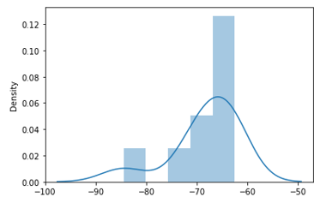
Cremation vs. Burial – Standard Scaler and Linear Regression

Slide 21
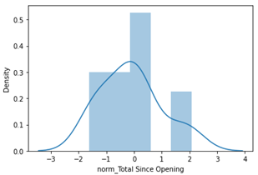
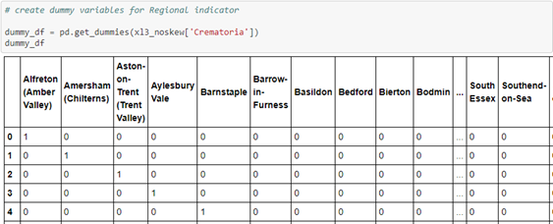
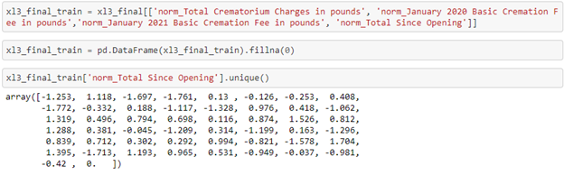
Crematorium – Random Forest Regression

Slide 22
Crematorium – Feature Scaling
Min-max scaler
Z-score normalized values with StandardScaler
Mean subtracted normalization (standardized)

Slide 23
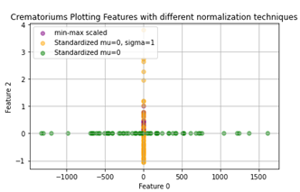
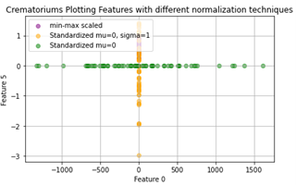
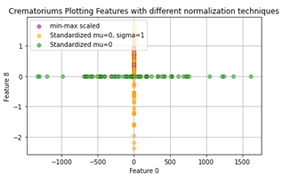
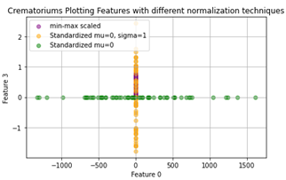
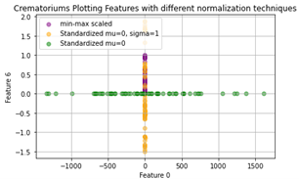
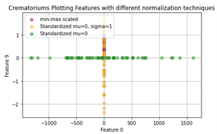
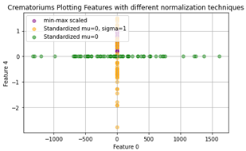
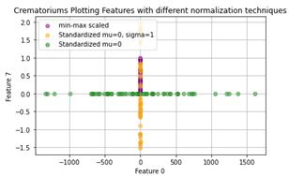
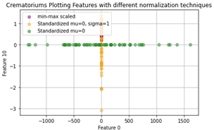
Z-score, Min-max, and mean subtracted standardized features at 0

Slide 24
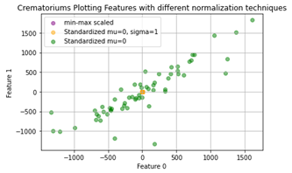
Z-score at 0
Feature 0: 1 Jan-31 Dec 2019
Feature 1: 1 Jan-31 Dec 2020

Slide 25
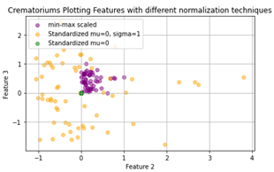
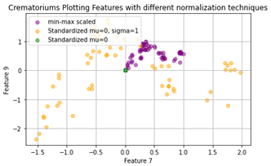
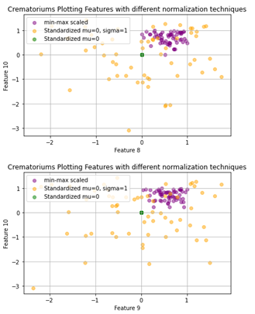
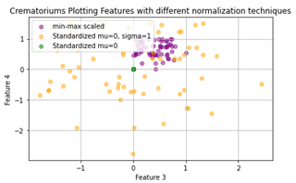
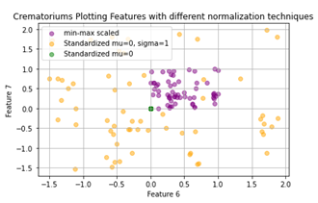
Mean Subtracted (standardized) at 0 and the Min-Max range (normalized) 0 to 1.

Slide 26
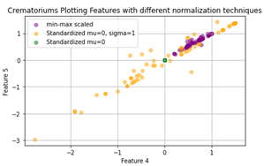
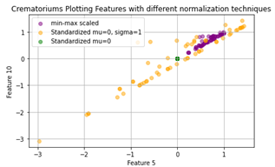
Positive slope from -1 to 1 AND MEAN SUBTRACTED (STANDARDIZED) AT 0.

Slide 27
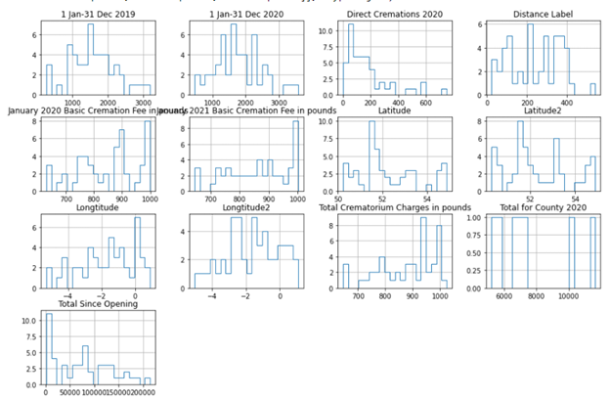
Crematorium – Fixing Skewness (Part 1)
Left-skewed: direct cremations 2020, distance label, and total since opening
Right-skewed: : January 2020 basic cremation fee in pounds, January 2021 basic cremation fee in pounds and total crematorium charges in pounds

Slide 28
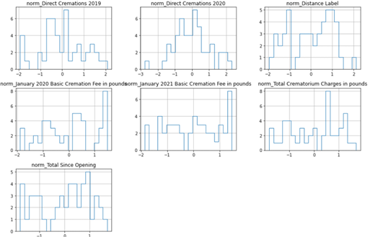
Crematorium – Fixing Skewness (Part 2)
Features now are more or less normally distributed or have more even distribution.

Slide 29
modeling

Slide 30
Limitations to building good model
Initial Model Ideas
Robust synthetic control model
Causal impact model to make predictions for burial and cremation rates in scenario where Covid-19 did not happen.
Data spans only max one year (2019-2020 or 2020-2021).
Data between 2016-2021 is cumulative; does not provide data per year.
Point-Biserial Correlation performed: PointbiserialResult(correlation = 0.291, p-value=0.06)

Slide 31
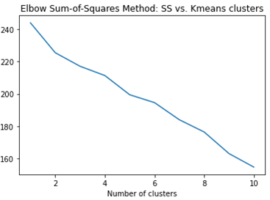
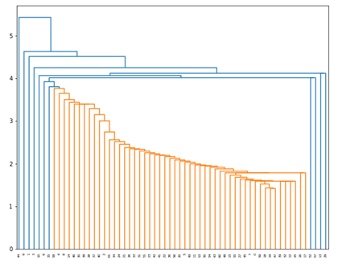
K-Means and Agglomerative/Hierarchical clustering

Slide 32
Answering Our Questions
Is there a growing demand for non-traditional burial in the U.K.?
- Yes, if we consider full body burial as traditional burial and cremation as non-traditional. Cremation is the top method of end-of-life disposition.
What would burial rates look like if Covid-19 did not happen?
- We are not able to answer this question; no working model produced.

Slide 33
Drawing Insights from Our Analysis
Average cremation fees in January 2021: ~£750 to £1500.
Average burial fees for a single grave for an adult from 2016 to 2021: ~£1000 to £5000.
Burial fees are approximately 20% more expensive than cremation fees.
Highest volume of cremations by a crematoria (in this data, it was Bournemouth Crematorium) in 2020 was 4,066.
Cemetery with the most bodies buried, St. Pancras & Islington Cemetery, has 812,000 burials.
Even though this cemetery is 190 acres, it will eventually reach its full capacity. Graves can be reused, but an exclusive right of burial or cremated remains plot is sold for at least 50 to 100 years, so cemeteries can get crowded whenever there is a surge of deaths within a population as the demand for plots increases while the supply is limited. On the other hand, there are various ways to preserve cremation ashes other than burial.

Slide 34
Drawing Insights from Our Analysis (continued)
Cremation costs are highest in Southwest England.
Peterborough had the highest basic cremation fees in 2021 (£1,002).
On the other hand, Purbeck, which is also in South England, had the lowest basic cremation fees (£538).
Bar graph showing distances between crematoriums were randomized, Truro had the longest distance because it was relative to Middlesbrough, where Truro is at the very Southwest of England and Middlesbrough in the North.
From 2016-2021, Highgate Cemetery had the highest burial costs (approximately £18,325) and Charlton Cemetery the lowest burial costs (about £657).
Magnificent Seven are the seven large private cemeteries in London. This includes Highgate Cemetery, Kensal Green Cemetery, West Norwood Cemetery, Brompton Cemetery, Abney Park Cemetery (closed), Nunhead Cemetery (closed) and Tower Hamlets Cemetery (closed).
Although Kensal Green and Brompton Cemeteries, according to our mapping analysis, are in the mid range of burial costs, between £8,000-£10,000, it is still higher than the majority cemeteries.
Privately owned cemeteries are more expensive.

Slide 35
Assumptions and Limitations
Data spans only maximum 1 year; not enough for time-series or causal impact model.
New perspective gained and ideas for improvements.
Collection of more secondary data for cemeteries outside of London area.
Further research for burial and cremation records divided years spanning more than 8 to 10 years.
Ensuring that coordinates for locations are precise.

Slide 36

Thank you!
Email: ymaq203@gmail.com
Linkedin: https://www.linkedin.com/in/yvonnemaeq/
Github: https://github.com/yuvemaq
Special thanks to my mentor, Kevin Ding

